Slide 1

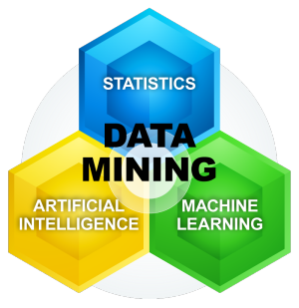
Data Mining
By
Adnan Amin
Im|sciences, Peshawar

Slide 2
DATA
Data are any facts, numbers, or text that can be processed by a computer.
operational or transactional data
E.g., sales, cost, inventory, payroll, and accounting.
nonoperational data
industry sales, forecast data, and macro economic data
meta data
data about the data itself,
logical database design or data dictionary definitions

Slide 3
INFORMATION
The patterns, associations, or relationships among all this data can provide information.
analysis of retail point of sale transaction data can yield information on which products are selling and when.

Slide 4
KNOWLEDGE
Information can be converted into knowledge about historical patterns and future trends.
A familiarity, awareness or understanding of someone or something.
Theoretical or practical understanding of a subject

Slide 5
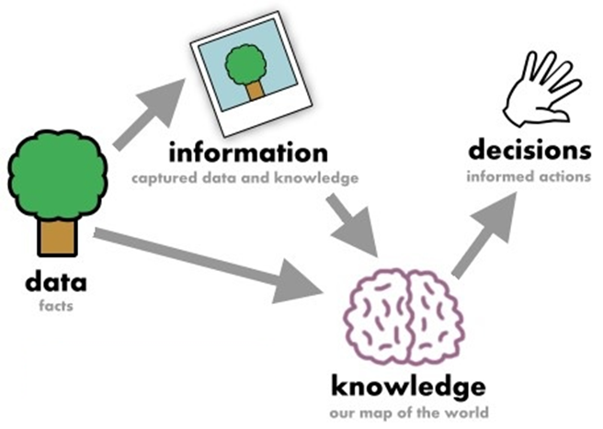
Relation

Slide 6
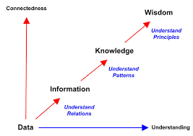

Slide 7
DATABASE
A database is a collection of information that is organized so that it can easily be accessed, managed, and updated.
Reduced data redundancy and increased data consistancy.

Slide 8
Data Warehouses
A relational database that is designed for query, analysis and reporting purpose rather than for transaction processing. It usually contains historical data derived from different sources of business's transaction data.

Slide 9
Motivation
Moving toward the Information Age:
“We are living in the information age” (NO)
“We are actually living in the data age” (YES)
Terabytes or petabytes data:
Sensors & Computer Networks
WWW & Social Media
Operational data

Slide 10
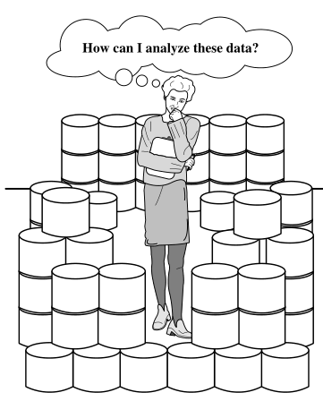
WHY DATA MINING
The Explosive Growth of Data
From terabytes to petabytes
We are drowning in data, but starving for knowledge.
The world is data rich but information poor situation.

Slide 11
Evolution of Sciences
Before 1600
Empirical Sciences
1600-1950
Theoretical science
1950-1990
Computational science
1990-Now
Data Science
Source: Jim Gray and Alex Szalay, The World Wide Telescope: An Archetype for Online Science, Comm. ACM, 45(11): 50-54, Nov. 2002

Slide 12
Empirical Science (Before 1600)
Empirical
Based on evidence.
In scientific method the word "empirical" refers to the use of working hypothesis that can be tested using observation and experiment.
Empirical data is produced by experiment and observation.

Slide 13
Theoretical Science (1600-1950)
Each discipline has grown a theoretical component.
Theoretical models often motivate experiments and generalize our understanding.
Theory? Fact ? Hypothesis ?

Slide 14
HYPOTHESIS
A hypothesis is an idea that hasn't been proven yet.
If enough evidence accumulates to support a hypothesis. Then it moves to the next step.. known as a theory.
Theory may change.

Slide 15
Theory and Fact
A theory usually has already survived several falsification attempts and is pretty well accepted.
“Theory” to mean any explanation of observations.
“Facts" refer to the observations. E.g. "It is a fact that the speed of light is constant in a vacuum."

Slide 16
Computational science (1950-1990)
Computational Science traditionally meant simulation.
It grew out of our inability to find closed-form solutions for complex mathematical models.

Slide 17
Data science (1990-Now)
The flood of data from new scientific instruments and simulations.
The ability to economically store and manage petabytes of data online.
The Internet and computing Grid that makes all these archives universally accessible.
Scientific info. management, acquisition, organization, query, and visualization tasks scale almost linearly with data volumes.
Challenge? Mining inside huge data in hand.

Slide 18
Evolution of Database Technology
1960s:
Data collection, database creation, IMS and network DBMS
1970s:
Relational data model, relational DBMS implementation
1980s:
RDBMS, advanced data models (extended-relational, OO, deductive, etc.)
Application-oriented DBMS (spatial, scientific, engineering, etc.)
1990s:
Data mining, data warehousing, multimedia databases, and Web databases
2000s
Stream data management and mining
Data mining and its applications
Web technology (XML, data integration) and global information systems

Slide 19
What’s Data Mining?

Slide 20
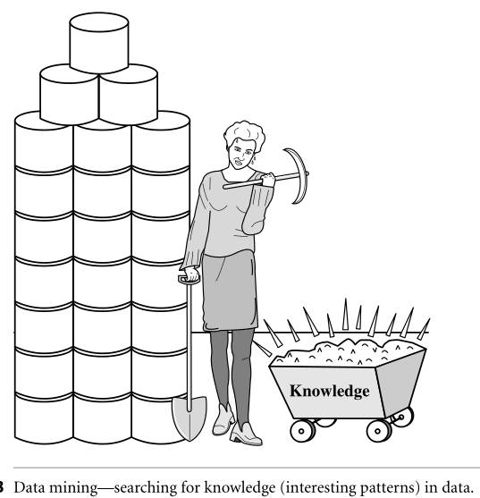

Slide 21
DATA MINING
Alternate Names:
Knowledge discovery in database (KDD).
Knowledge Extraction
Data/Pattern Analysis
Data Archeology
Business Intelligence
Why Knowledge Mining from the Data?

Slide 22
Why KDD?
To refer to the mining of gold from rocks or sand, we say gold mining instead of rock or sand mining.
Therefore,
knowledge mining from data is simply refer to Data mining.

Slide 23
Definition 1
Extracting the most prominent features of the data and ignoring the rest. (Book Mining of Massive data by Jure et al.)

Slide 24
Definition 2
Extraction of interesting (non-trivial, implicit, previously unknown and potentially useful) patterns or knowledge from huge amount of data.

Slide 25
Data mining definition conti..
Data mining finds valuable information hidden in a large volumes of data.
Data mining is the analysis of data and the use of software techniques for finding patterns and regularities in sets of data.

Slide 26
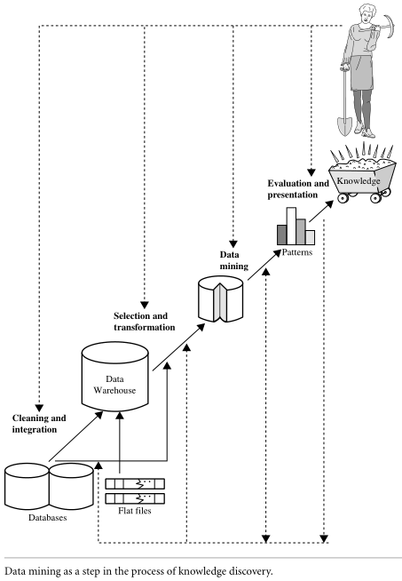

Slide 27
Data mining- Core of Knowledge discovery process
Knowledge
Pattern Evaluation
Data Mining
Task-relevant Data
Data Warehouse
Selection
Data Cleaning
Data Integration
Databases

Slide 28
Iterative Sequence of KDD
Data cleansing
Data Integration
Data Selection
Data transformation
Data mining
Pattern evaluation
Knowledge presentation
Steps 1 through 4 are differnet forms of data preprocessing, where data are prepared for mining.
Step 5 can interact with the user or a knowledge base.
Step 6 and 7are presentation to the user and
may be stored as new knowledge base.

Slide 29
1. Data Cleansing
Removing noise, incompleteness and inconsistency from the real-word data.
It is the process to:
Fill in the missing values,
Smooth out noise,
Identifying outliers,
Correct inconsistencies in the data.

Slide 30
2. Data Integration
Where multiple data sources may be combined.
Data mining often requires data integration:
Merging of data from multiple data stores,
Reduce and avoid redundancies and inconsistencies in the resulting data set.
Improve the accuracy and speed of the subsequent data mining process.

Slide 31
4. Data Transformation
Where data are transformed and consolidated into forms appropriate for mining by performing summary or aggregation operations.
Due to DT process:
Mining can be more efficient,
Easier to understand and find patterns
Data discretization

Slide 32
5. Data mining
An essential process where intelligent methods are applied to extract data patterns.

Slide 33
6. Pattern evaluation
To identify the truly interesting patterns representing knowledge based on interestingness measures.

Slide 34
7. Knowledge presentation
Where visualization and knowledge representation techniques are used to present mined knowledge to users.

Slide 35
Data Mining and Business Intelligence
Increasing potential
to support
business decisions
End User
Decision Making
Data Presentation
Business
Analyst
Visualization Techniques
Data Mining
Data
Analyst
Information Discovery
Data Exploration
Statistical Summary, Querying, and Reporting
Data Preprocessing/Integration, Data Warehouses
Data Sources
DBA
Paper, Files, Web documents, Scientific experiments, Database Systems

Slide 36
Data Mining: Confluence of Multiple Disciplines
Database
Technology
Statistics
Machine
Learning
Data Mining
Visualization
Pattern
Recognition
Other
Disciplines
Algorithm

Slide 37
Data Mining: On What Kinds of Data?
Database-oriented data sets and applications
Relational database, data warehouse, transactional database
Advanced data sets and advanced applications
Data streams and sensor data
Time-series data, temporal data, sequence data (incl. bio-sequences)
Structure data, graphs, social networks and multi-linked data
Object-relational databases
Heterogeneous databases and legacy databases
Spatial data and spatiotemporal data
Multimedia database
Text databases
The World-Wide Web

Slide 38
Thanks
Sources:
Data Mining Concepts and Techniques 3rd Edition by Jiawei Han, Micheline Kamber & Jian Pei

